Slide 1
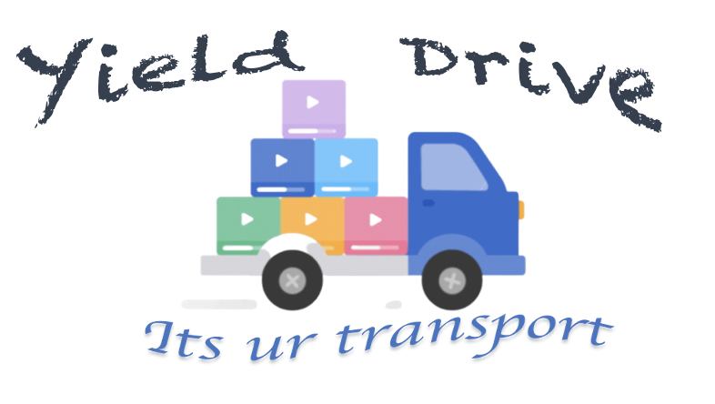
Team Members
P Gayatri Varma 17251A0508
K Venkata Srihitha 17251A0542
Thota Sudharani 18255A0506
Head of the Department
Dr.M.Seetha
Professor & HOD
Department of CSE
Internal Guide
Dr.A.Sharada
Professor
Department of CSE

Slide 2
Contents:
Introduction
Existing System
Proposed System
Objectives
Architecture
Use case Diagram
Requirements
Modules
Design
Database Implementation
Results & Test cases
Conclusion and Future scope
References

Slide 3
Introduction:
Post harvest management i.e, transportation and storage of yield are the phases of farming where a farmer spends more money before the yield is sold.
Transportation of agricultural produce plays very important role in gaining profits if the crop yield is less.
Every farmer has to hire a vehicle to transport the yield irrespective of the quantity of yield produced.
Price of hiring a vehicle varies from one place to other, also in some cases a farmer cant afford the transportation cost.
In most of the cases, efficiency of the vehicle hired may not be completely utilized.
In order to make it completely utilized and also make transport feasible for the farmers, the current app “Yield Drive” is designed
In this app, farmers can do transportation pooling where more than one farmer share the vehicle based on their requirement and share their expenses, leading to increase of profits.

Slide 4
Existing System:
At present, a farmer uses various modes of transport based on the amount he can spend. Each farmer hires a vehicle for him alone leading to increased cost of transportation.
The main disadvantage of this system is, efficiency of the transportation vehicle is not completely utilized.
In some cases, transportation vehicles might not be available due to various reasons. During these situations, he can not transport his crop yield.

Slide 5
Proposed System:
The proposed system helps farmers in transportation pooling where a single transportation vehicle can be used by multiple farmers at the same time to transport their crop yield. Here, yield of multiple farmers can be transported within the cost of one farmer. So, the amount spent by farmers on transportation varies according to the amount of crop yield produced.
By transportation pooling method, the space in the vehicle can also be utilized efficiently and the cost spent over transportation can also be significantly reduced.

Slide 6
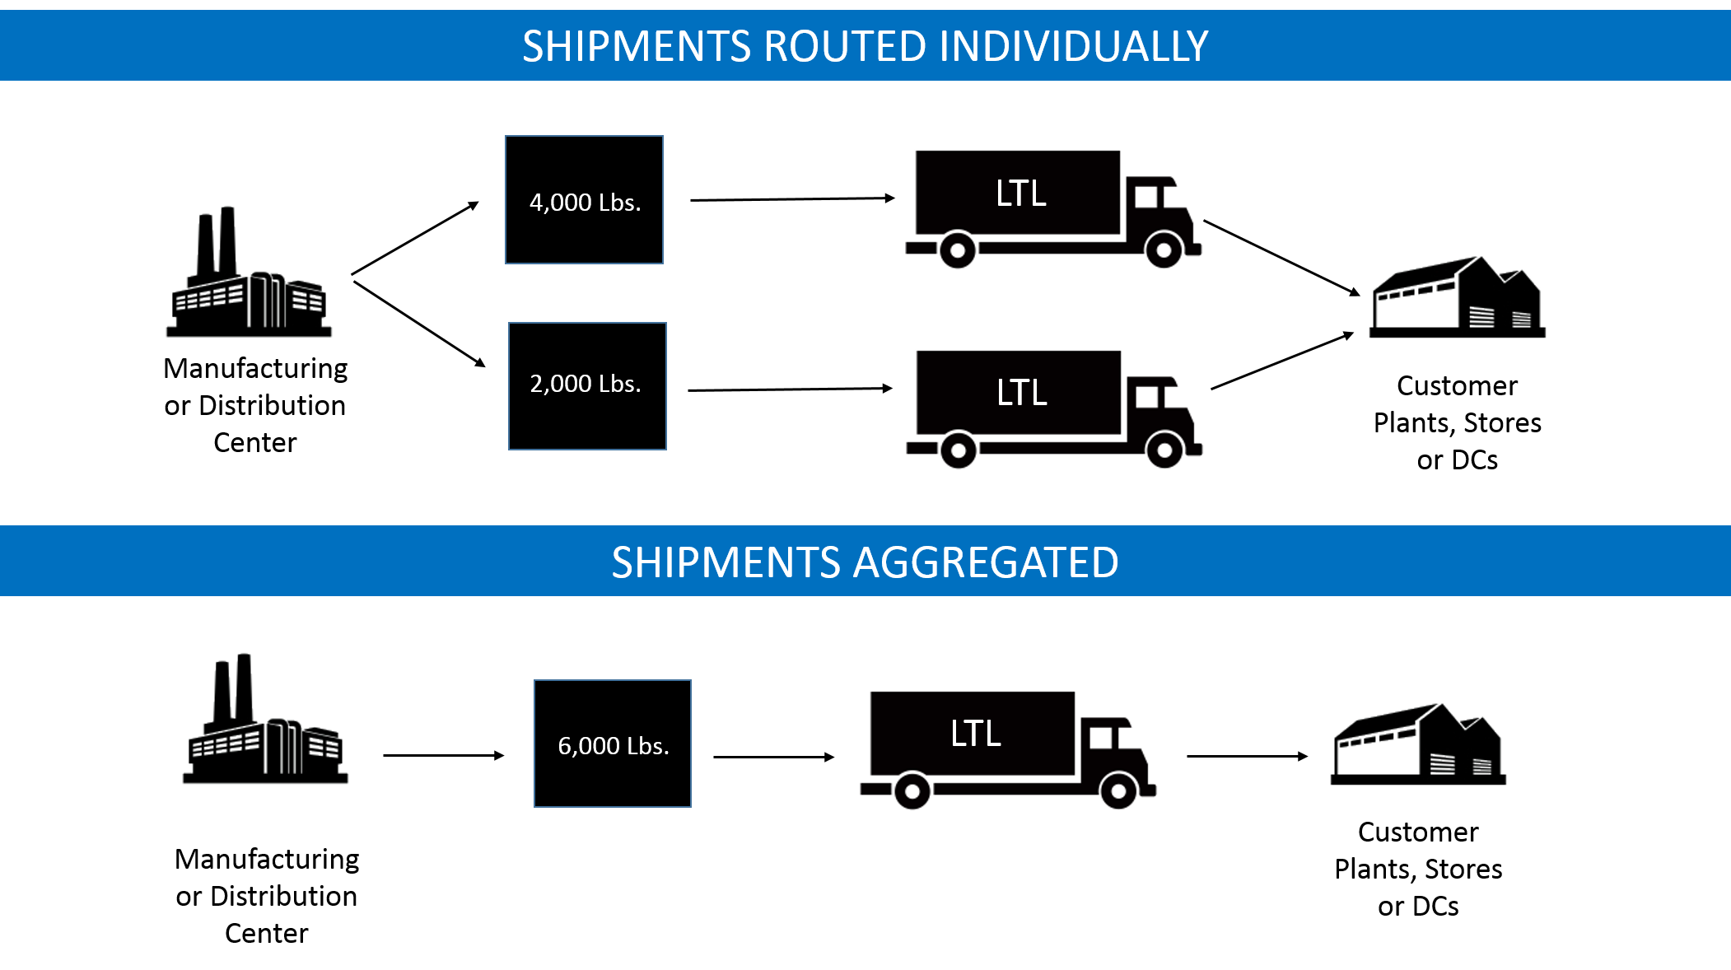
Objectives:
Develop an android app for pooling the transport of harvested crop
To utilize the capacity of vehicle efficiently
To save transportation cost of yield
Without pooling
With pooling

Slide 7
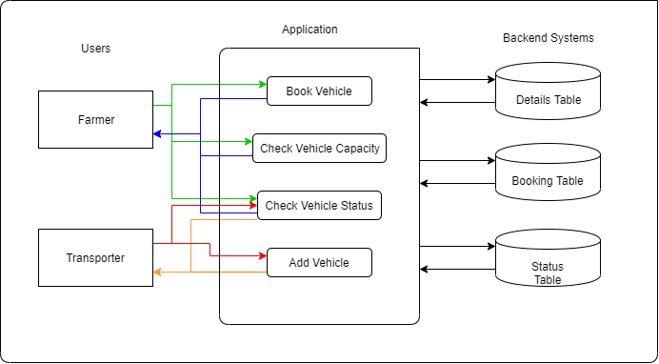
Architecture:

Slide 8
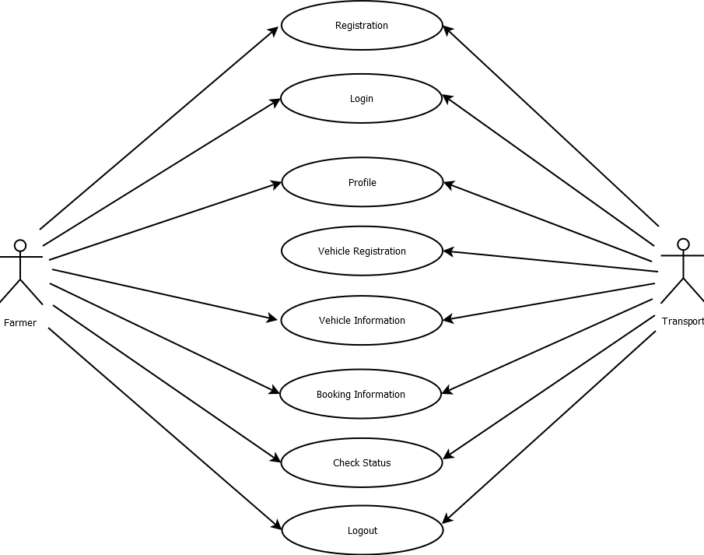
Use case diagram:

Slide 9
Requirements:
Technical
Hardware
Platform: Android Studio
Operating System: Android
Database connectivity: SQLite
Backend: Java
Frontend: XML
Operating System: Mac OS X, Windows 10
Name of processor: (min) Intel core i3
Hard disk capacity: 256GB
RAM capacity: 8GB

Slide 10
Modules:
In this application there are two different modules.
1. Transportation provider Module:
In this module transport provider can register by providing details like user id, password, mobile number and email id.
After registration, transport vendor can login with his user id and password.
After successful login, he can register a vehicle by providing vehicle information.
This information can be shared with farmers to do the vehicle bookings.
2. Farmer Module:
In this module farmers can register by providing details like user id, password, mobile number and email id.
After registration, farmers login with their user id and password.
After successful login, farmer can view the vehicle information and book the vehicle according to his requirement.
After the booking is made, the details of farmer are updated to transport vendor.

Slide 11
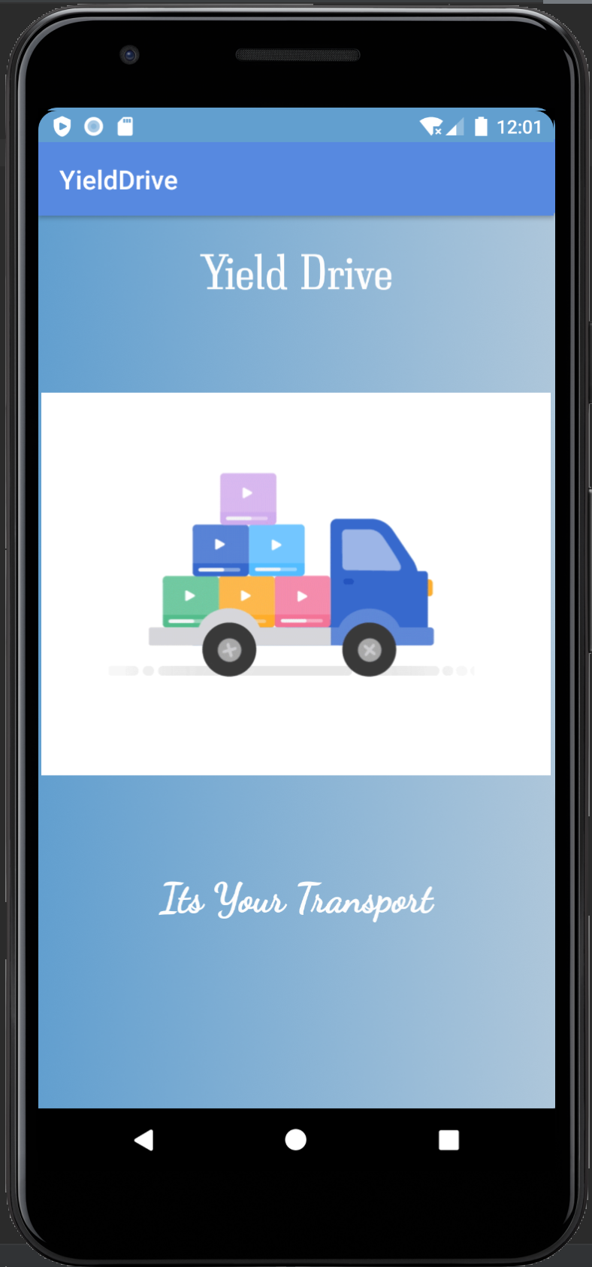
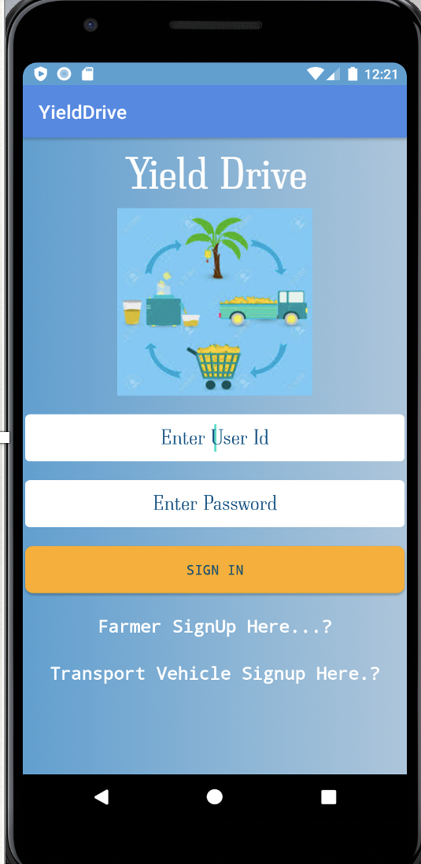
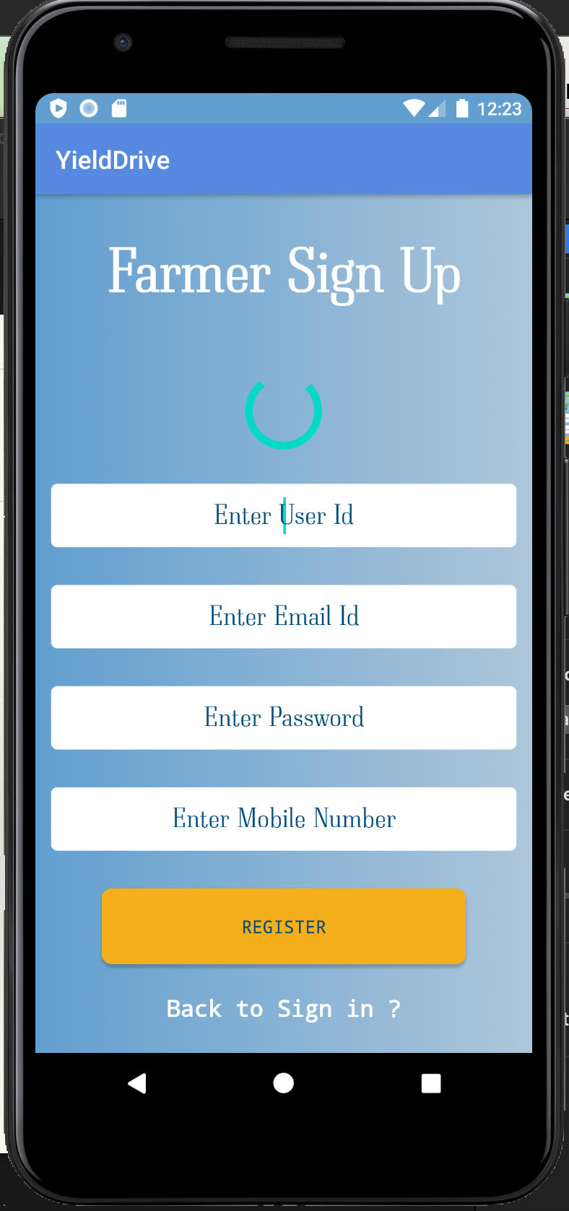
Design:

Slide 12
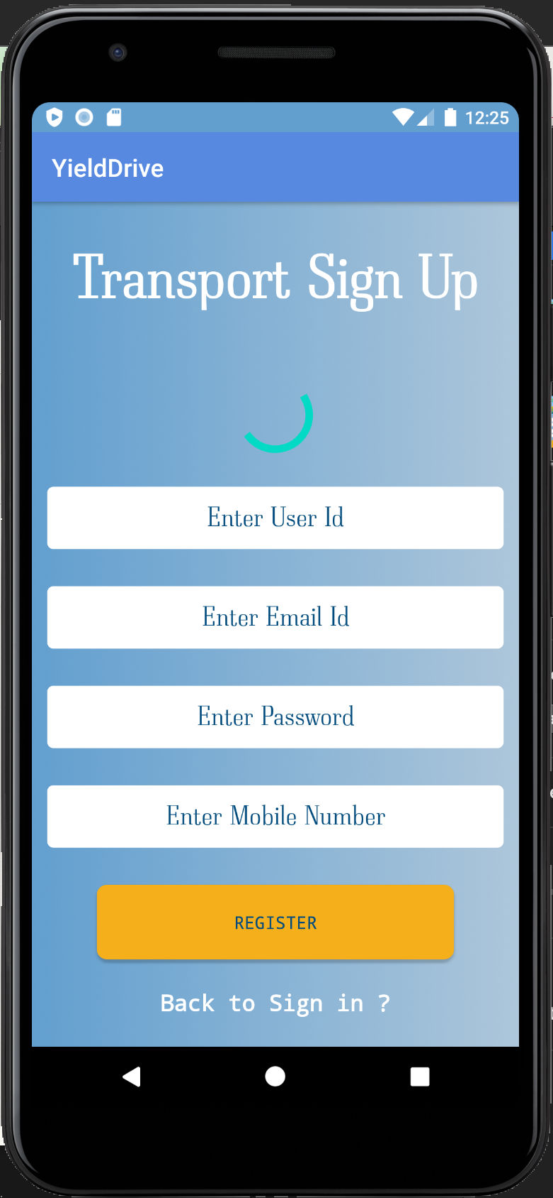
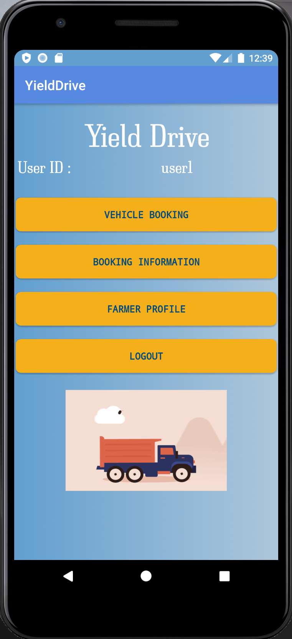
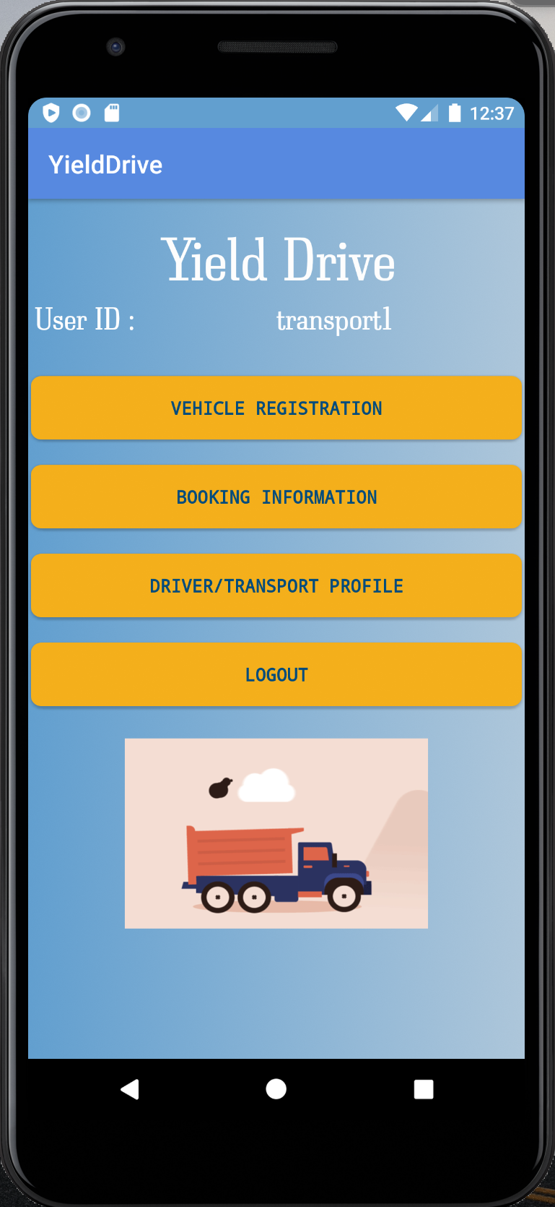

Slide 13
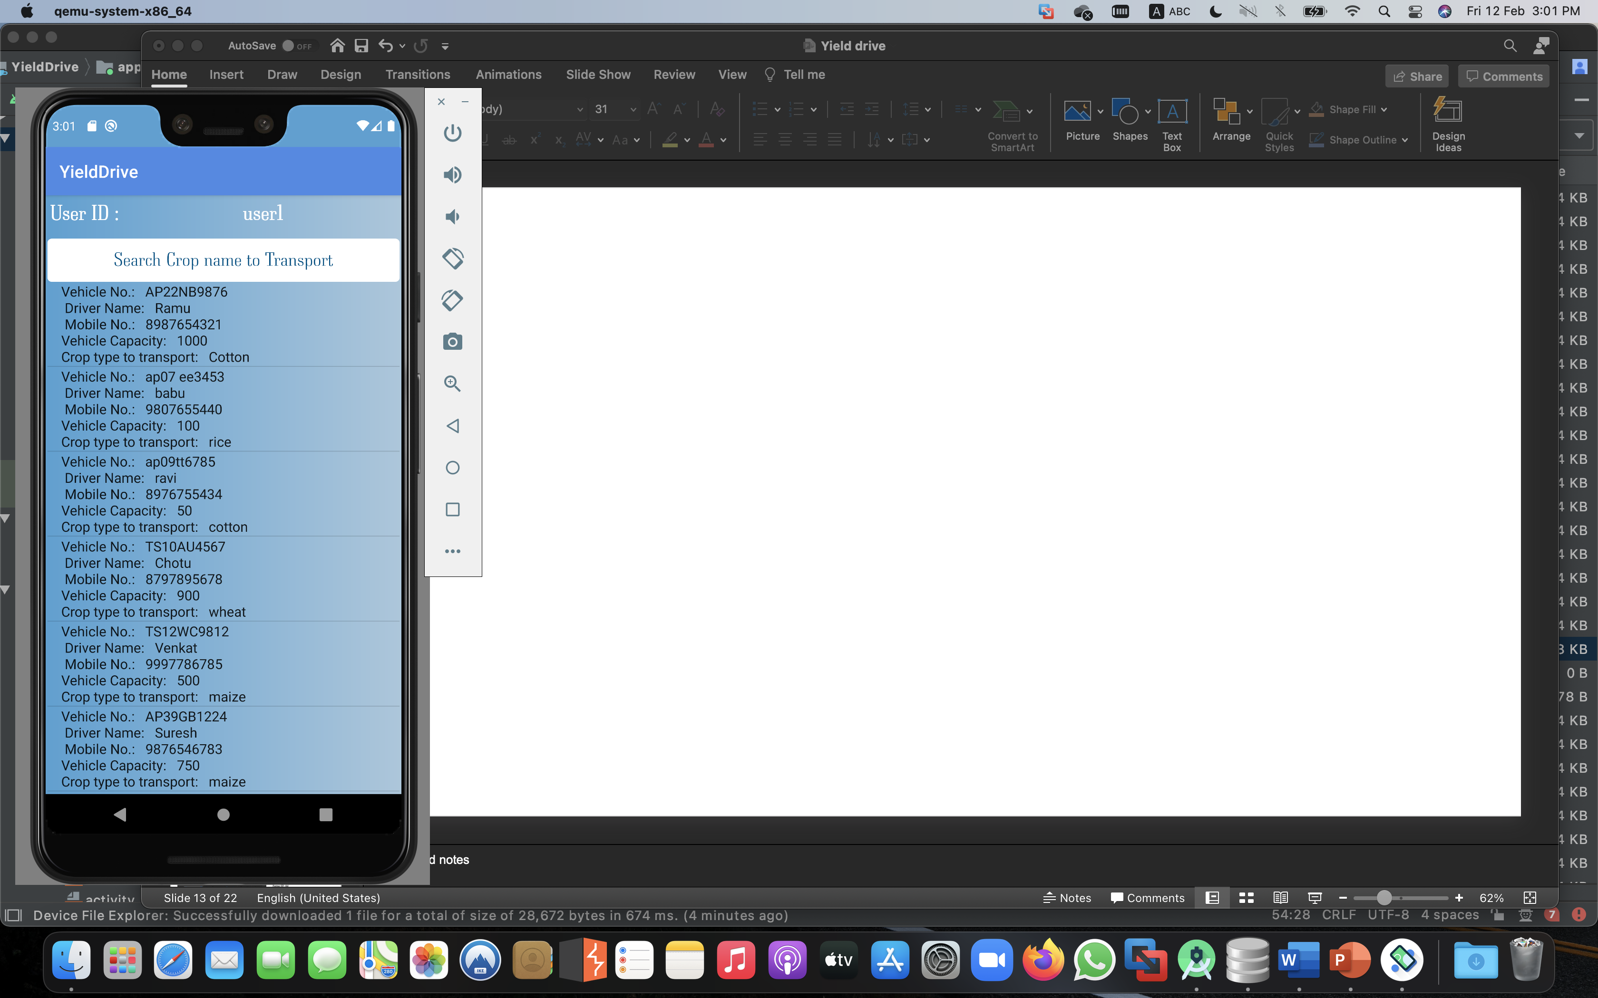
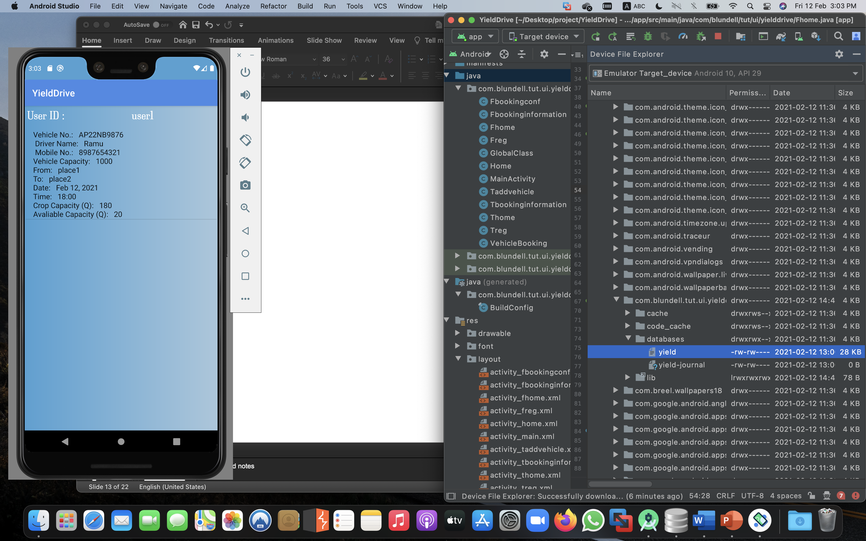
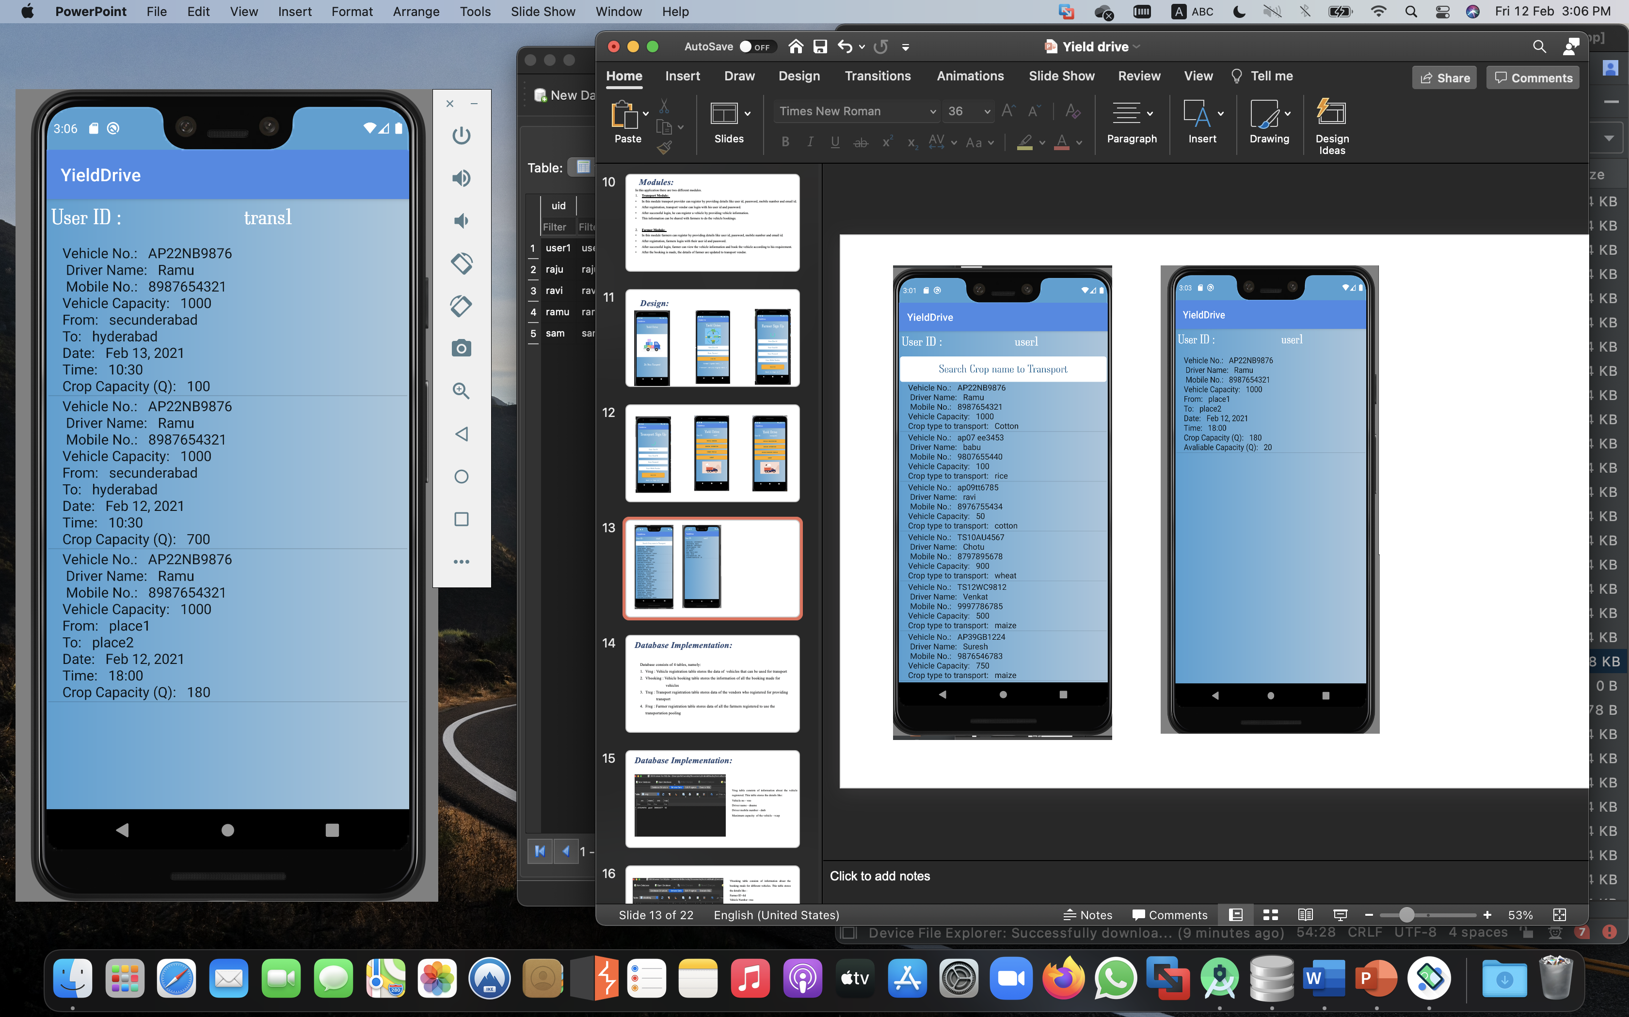

Slide 14
Database Implementation:
Database consists of 4 tables, namely:
Vreg : Vehicle registration table stores the data of vehicles that can be used for transport
Vbooking : Vehicle booking table stores the information of all the booking made for vehicles
Treg : Transport registration table stores data of the vendors who registered for providing transport
Freg : Farmer registration table stores data of all the farmers registered to use the transportation pooling

Slide 15
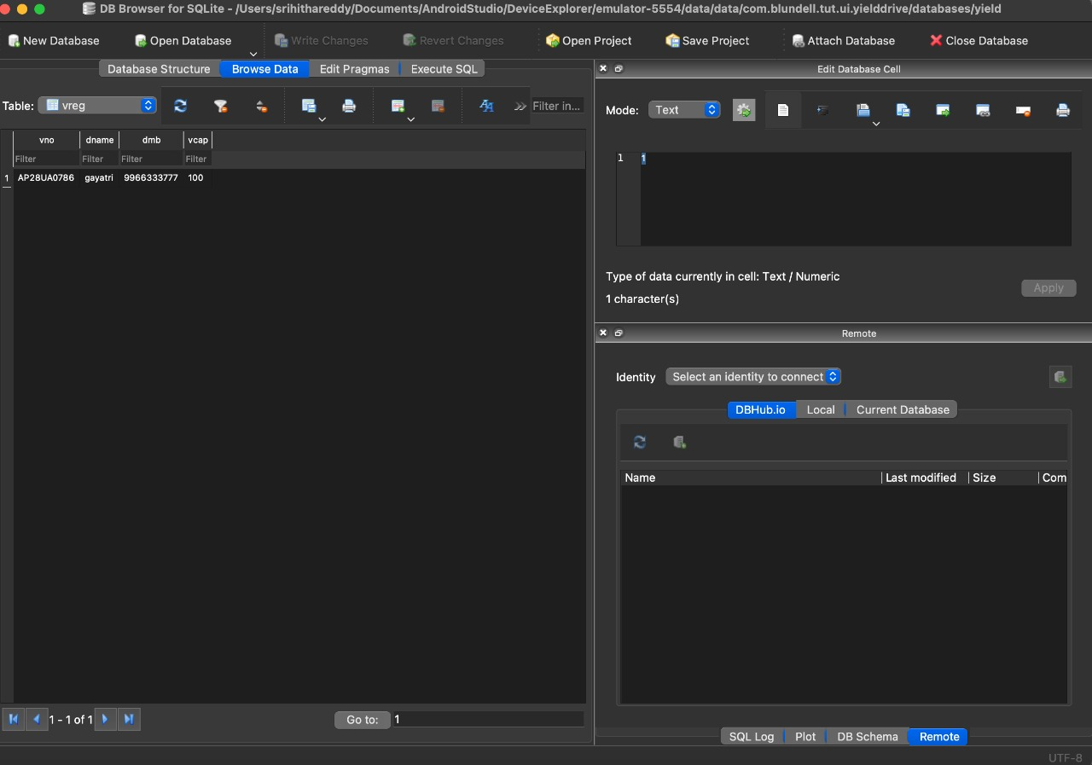
Database Implementation:
Vreg table consists of information about the vehicle registered. This table stores the details like:
Vehicle no - vno
Driver name - dname
Driver mobile number - dmb
Maximum capacity of the vehicle - vcap

Slide 16
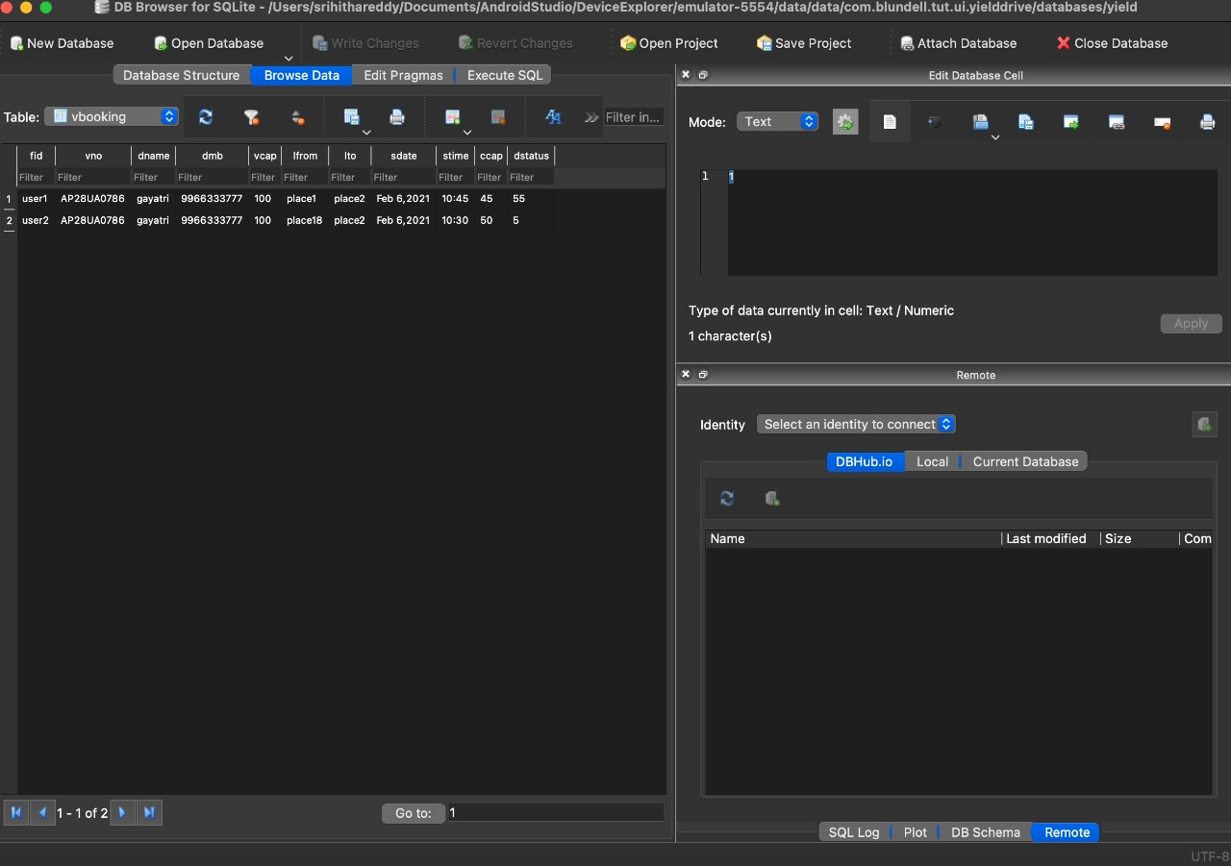
Vbooking table consists of information about the booking made for different vehicles. This table stores the details like :
Farmer ID -fid
Vehicle Number -vno
Driver Name -dname
Driver Mobile Number -dmb
Maximum vehicle capcity -vcap
From location -lfrom
To location -lto
Booking date -sdate
Booking time -stime
Capacity required -ccap
Remaining capacity -dstatus

Slide 17
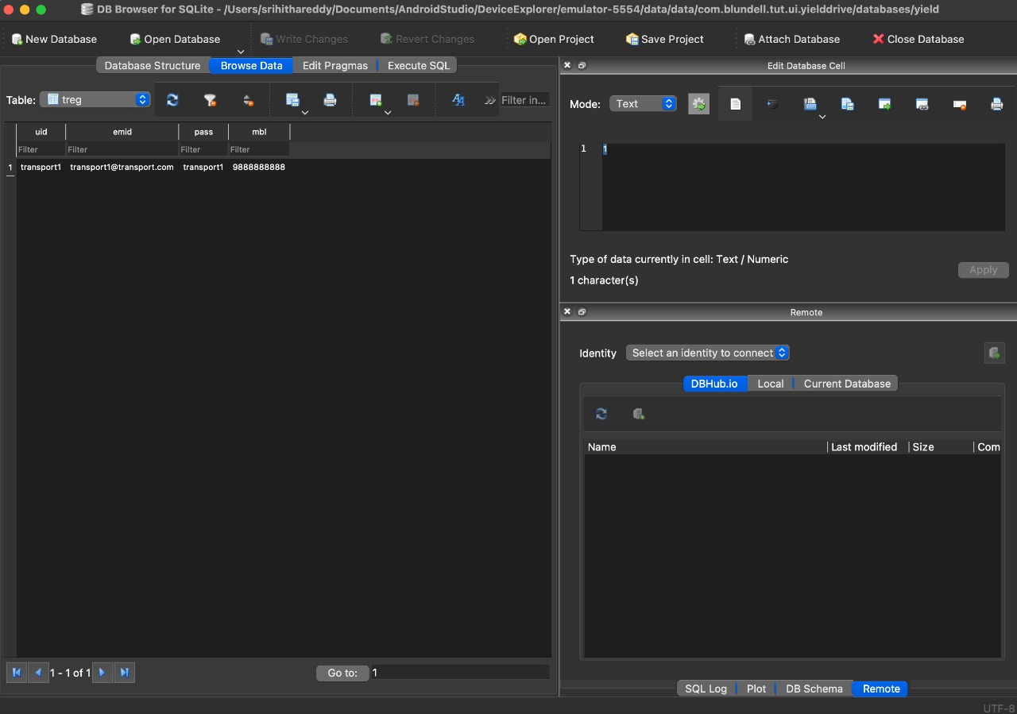
Treg table consists of information of the vendors who registered to provide transportation vehicles to the farmers. This table stores the details like
Transport provider id – uid
Email ID –emid
Password-pass
Mobile number -mbl

Slide 18
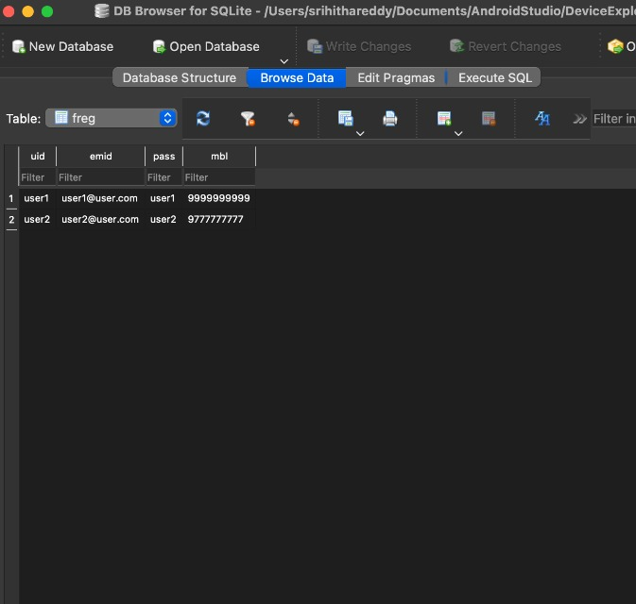
Farmer table consists of information about the farmer who registered.This table stores the details like:
Farmer id - uid
Email id -emid
Password -pwd
Mobile number -mbl

Slide 19
Results and test cases:
S.No | Input | Expected output | Actual Output | Result pass/Fail
1 | Registering with same user id | User Id already exists | User ID already exists | Pass
2 | If username and password is given wrong | Login failed | Login failed | Pass
3 | Overloading vehicle while booking it for first time | Vehicle overloaded first | Vehicle overloaded first | Pass
4 | Overloading vehicle while booking it (but not first time) | Vehicle overloaded last | Vehicle overloaded last | Pass

Slide 20
Conclusion and Future Scope:
The app designed “Yield Drive” is a user friendly, simple and easily accessible app which makes it feasible for farmers to transport the crop yield produced in a cost efficient manner. Space of transport vehicle can also be used efficiently.
In future enhancement we can add the GPS system in this application then farmers get the live location, we can also add the billing system into this application.

Slide 21
References:
Herbert Schildt.2008 ,”Java Complete Reference”, Tata McGraw-Hill , 7th Edition, pp. 177-180.
GradyBrooch,James Rambaugh.1998,“UnifiedModeling Language User Guide”, Addison Wesley Publishing, chapter 8-31.
WEBSITES: REFERRED URLS:
www.android.com http://developer.android.com/index.html
www.google.com http://en.wikipedia.org/wiki/SQLite

Slide 22


